Slide 1

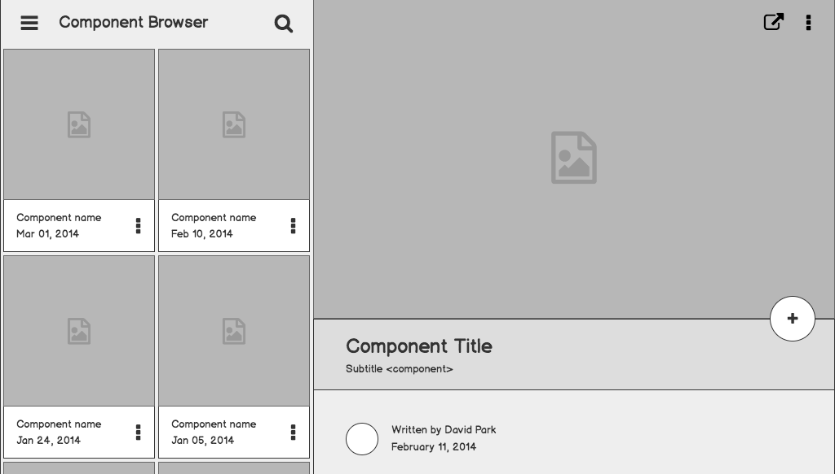

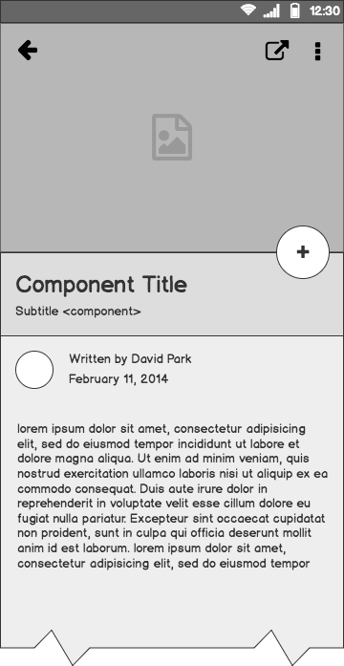
MESSAGATOR
(Message Translator)
Vibha K Chitravvara

Slide 2
Outline
Introduction
Flow Diagram
Tkinter
Selenium
Threads
Learnings

Slide 3
Intro
Messagator is a project which comprises of two parts mainly, a social media platform (preferably Whatsapp) and a GUI where the messages are fetched into and translated.
The interaction between the two is accomplished through Threads.
We’ll learn about each one of them in detail in the upcoming slides.

Slide 4
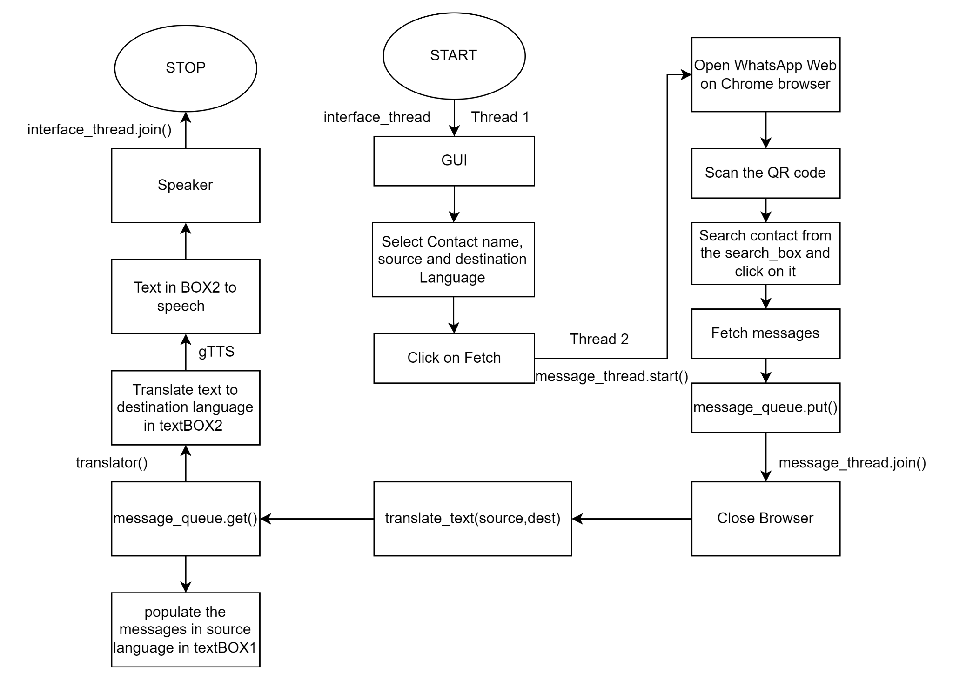

Slide 5
Tkinter
Tkinter is the standard GUI library for Python. Python when combined with Tkinter provides a fast and easy way to create GUI applications

Slide 6
WIDGETS
Label : Used to display text or image
Button : Used to add Buttons
Combobox : It contains a down arrow to select from list of available options
Text : The text widget mainly provides a multi-line text field to the user where users and enter or edit the text and it is different from Entry.
Frame : In order to group and organize another widgets Frame widget will be used. Basically it acts as a container that holds other widgets.

Slide 7
Selenium
Selenium is a powerful tool for controlling web browsers through programs and performing browser automation

Slide 8
Selenium is an open source library.It works on all OS and almost all the web browsers like Firefox, Chrome, Opera etc.
To install Selenium for python we use : pip install selenium
In order to work with selenium we need a webdriver. For example, for Chrome we have ChromeDriver.exe, Firefox it is Geckodriver.exe, etc.
There are only two actions performed in any automation tool.
Element identification
Performing action on the particular element

Slide 9
Threads
Thread is an entity within a process that can be scheduled for execution. It is a sequence of instructions within a program that can be executed independently of other code

Slide 10
MULTITHREADING Benefits
Following are the benefits to create a multithreaded application in Python, as follows:
It ensures effective utilization of computer system resources.
Multithreaded applications are more responsive.
It shares resources and its state with sub-threads (child) which makes it more economical.
It saves time by executing multiple threads at the same time.
The system does not require too much memory to store multiple threads.

Slide 11
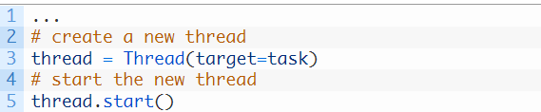
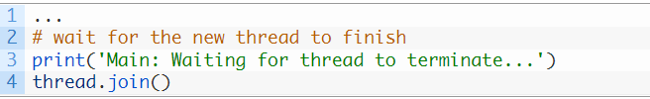
Thread methods
start() - Starts thread’s activity. It must be called at most once per thread.
join() - Joins current instance of the thread to the main thread. Thereby terminating the current thread.
Thread instance configured to execute our new task() function, then execute the thread by calling the start() function.

Slide 12
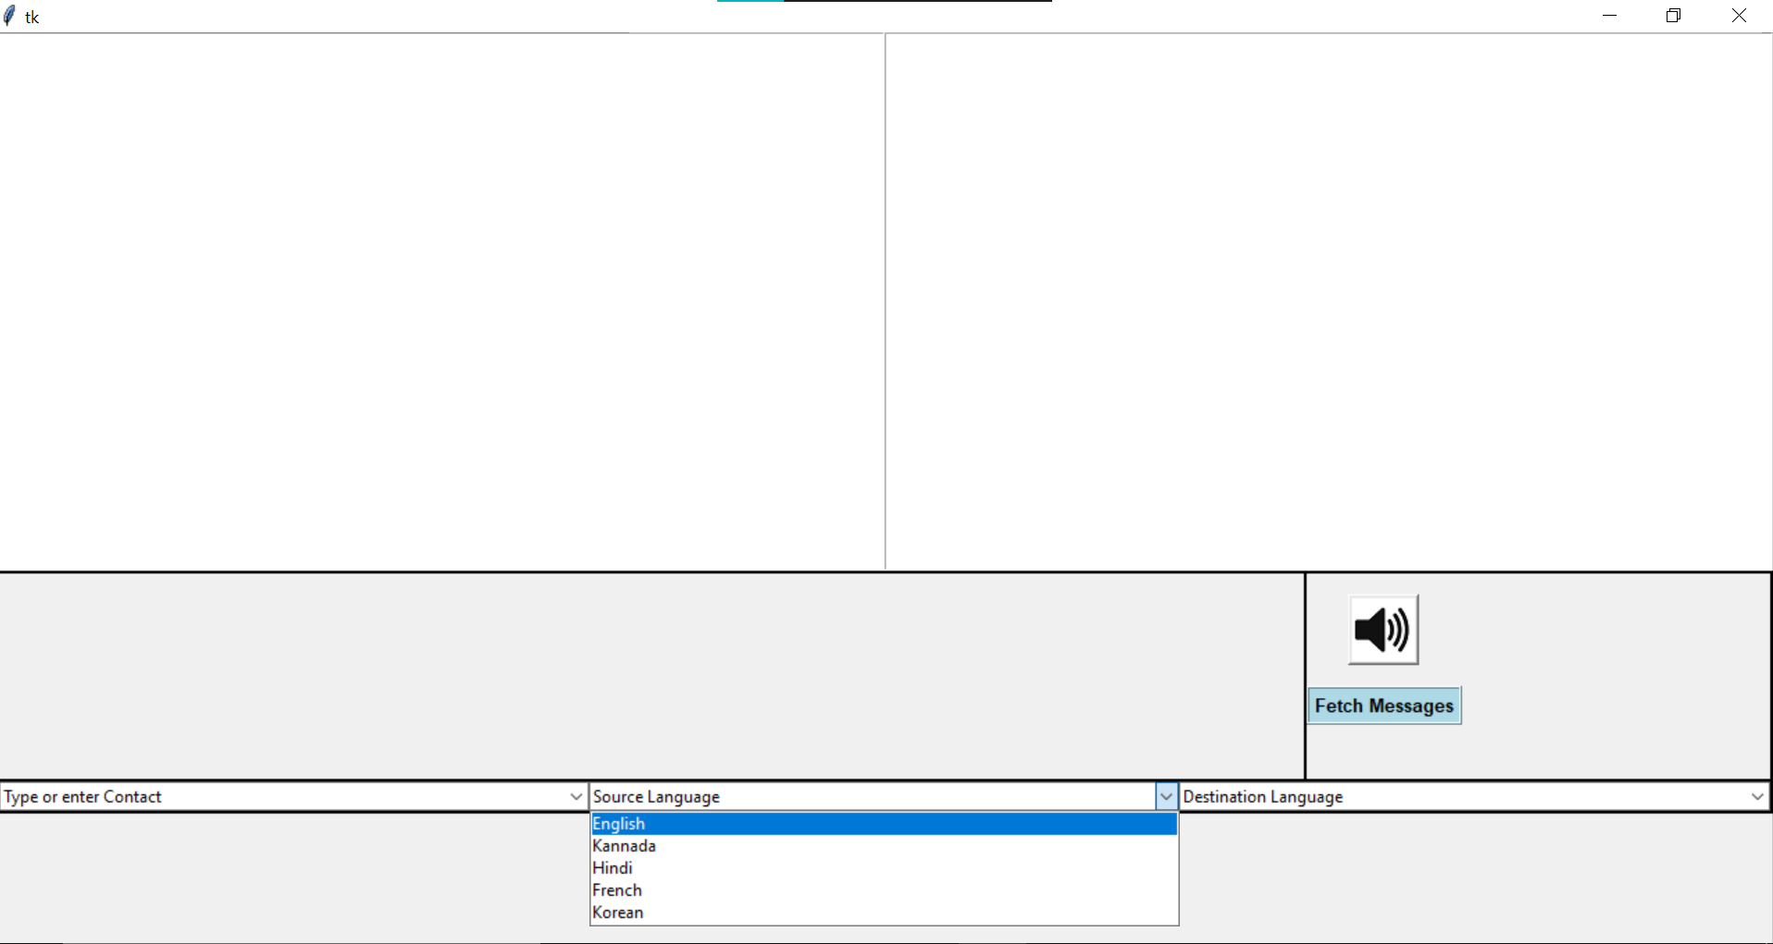
Learnings:
Tk interface
Selenium and automation
Multithreading working
Using Visual Studio code for the project
Debugging
Stackoverflow

Slide 13
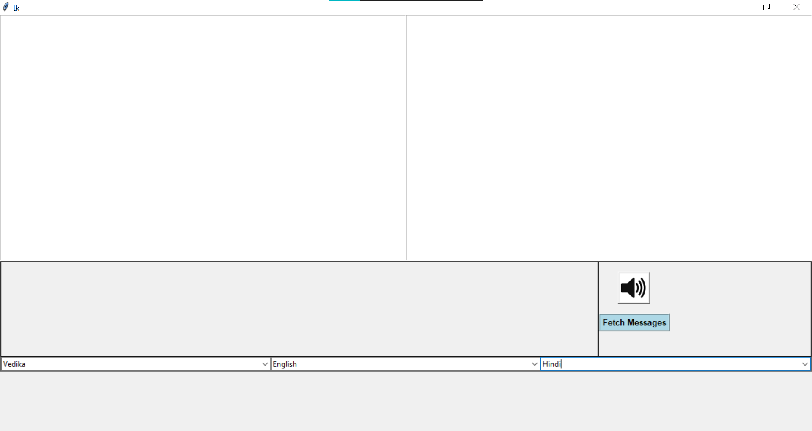

Slide 14
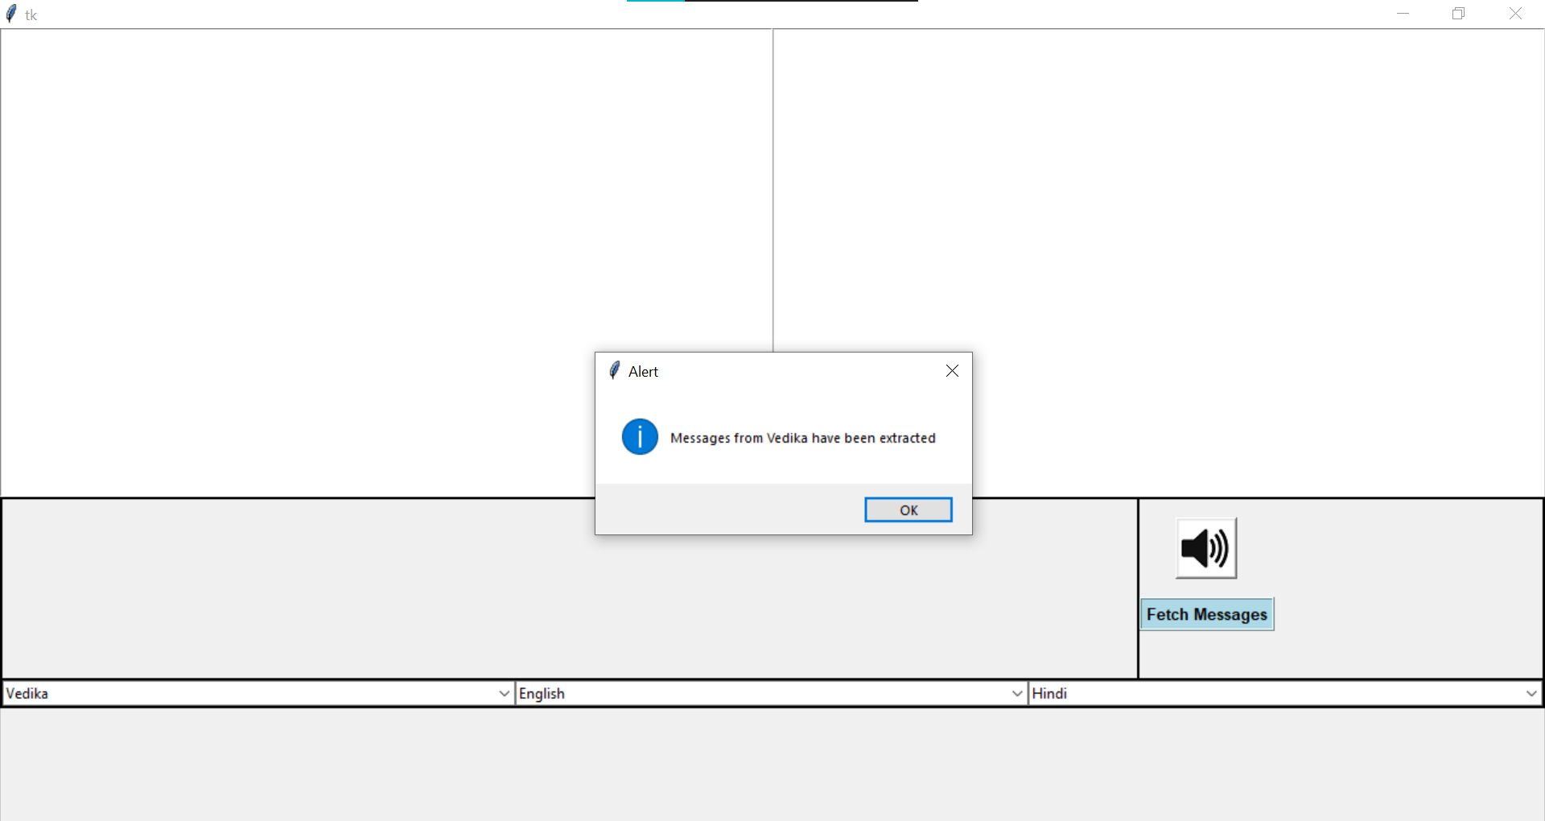

Slide 15
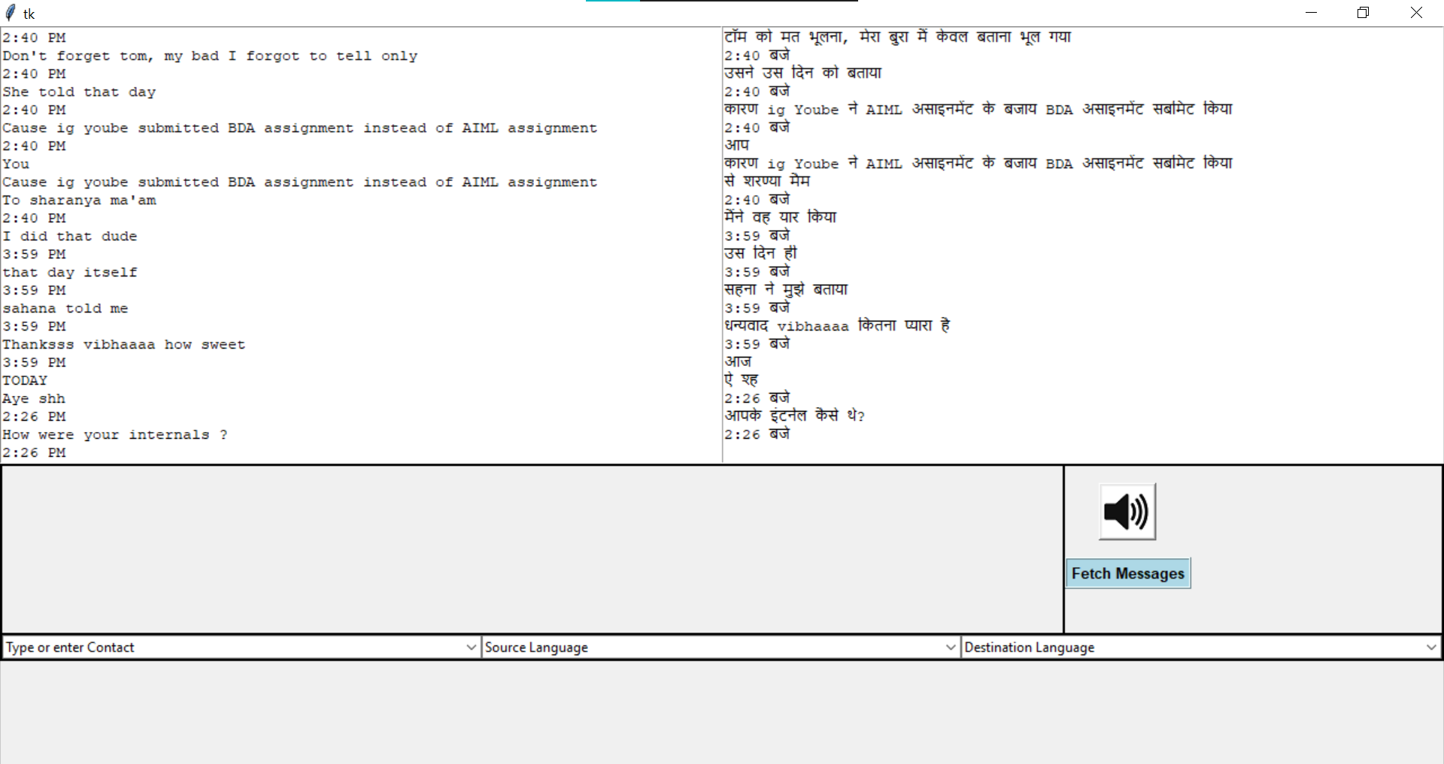

Slide 16
Learnings:
Tk interface
Selenium and automation
Multithreading working
Using Visual Studio code for the project
Debugging
Stackoverflow
What next :
Learn how to make apt use of threads to increase performance
What more can we do with selenium
Any other interfaces like Tkinter
Making the code look better

Slide 17
Github : https://github.com/3vivi3

Slide 18
References
Tkinter - https://realpython.com/python-gui-tkinter/
Selenium - https://www.geeksforgeeks.org/selenium-python-tutorial/
- https://pypi.org/project/selenium/
Multithreading - https://www.javatpoint.com/multithreading-in-python-3
- https://superfastpython.com/threading-in-python/

